Slide 1
Design Patterns In Games
FSMs, Stacks, AND other ideas
Based on slides by Kryzysztof Pietroszek which were based on Robert Zubek’s Game Programming Patterns and his lecture at Northwestern University

Slide 2
What are software design patterns?
Type it in the chat but don't submit it yet!
I will say "3. 2. 1. Go!" then submit your answer.

Slide 3
What are software design patterns?
“Design Pattern - element of reusable object oriented software”
Every software engineer knows design patterns.
It is good to have formalized knowledge however.
Some design patterns are used more than others, especially in game programming.

Slide 4
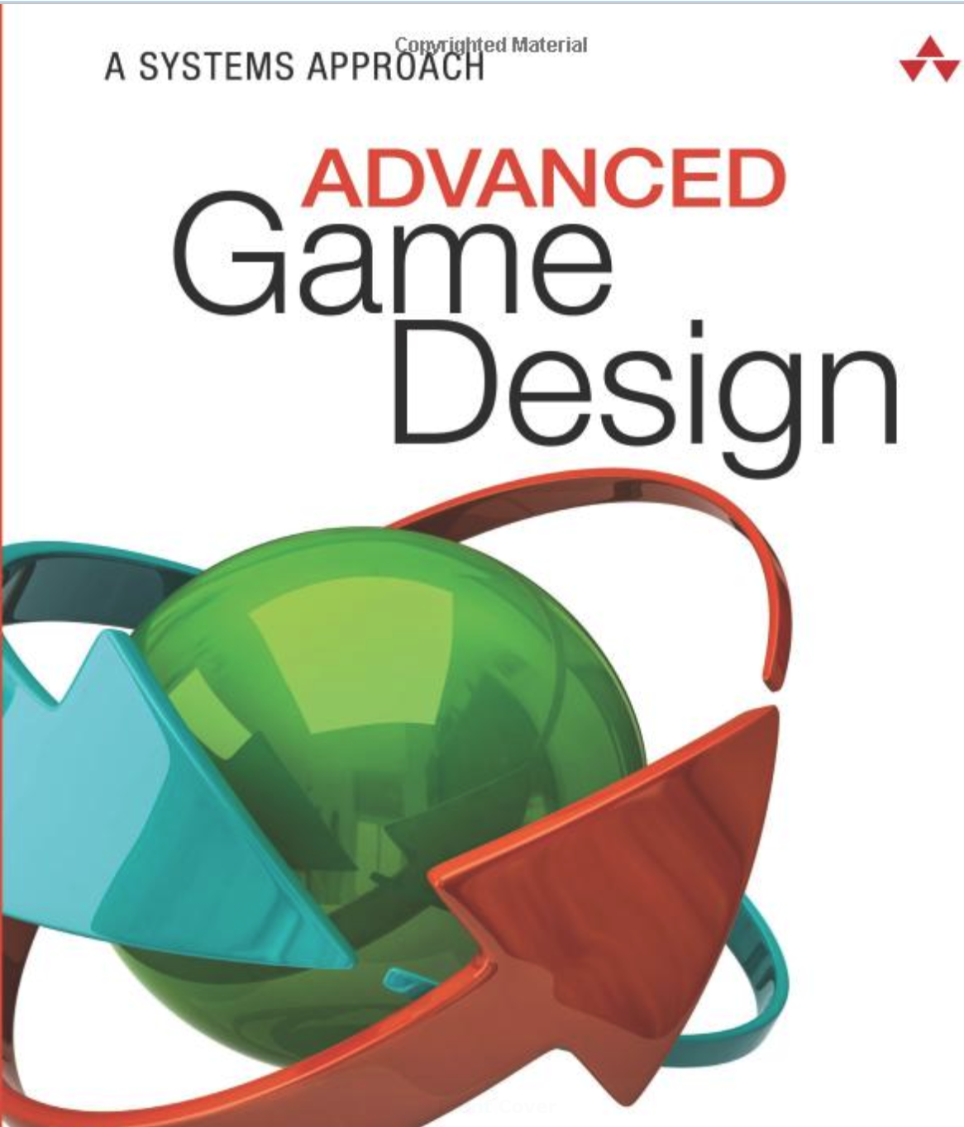
Advanced Game Design A Systems Approach
ISBN-13: 978-0134667607
ISBN-10: 0134667603
O'Reilly Link

Slide 5
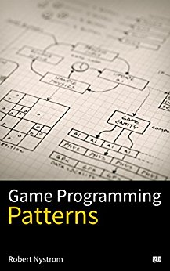
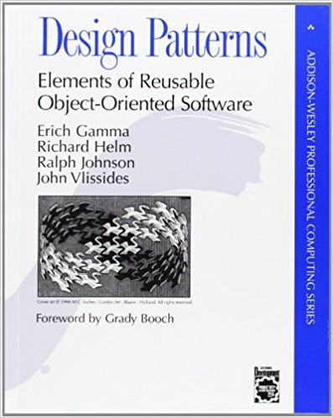
Our Other Textbooks
Design Patterns: Elements of Reusable Object-Oriented Software
Not Cheap
PDF versions exists…
A good reference to have
Game Programming Patterns by Robert Nystrom
$3 for the kindle version
Or free for the web version

Slide 6
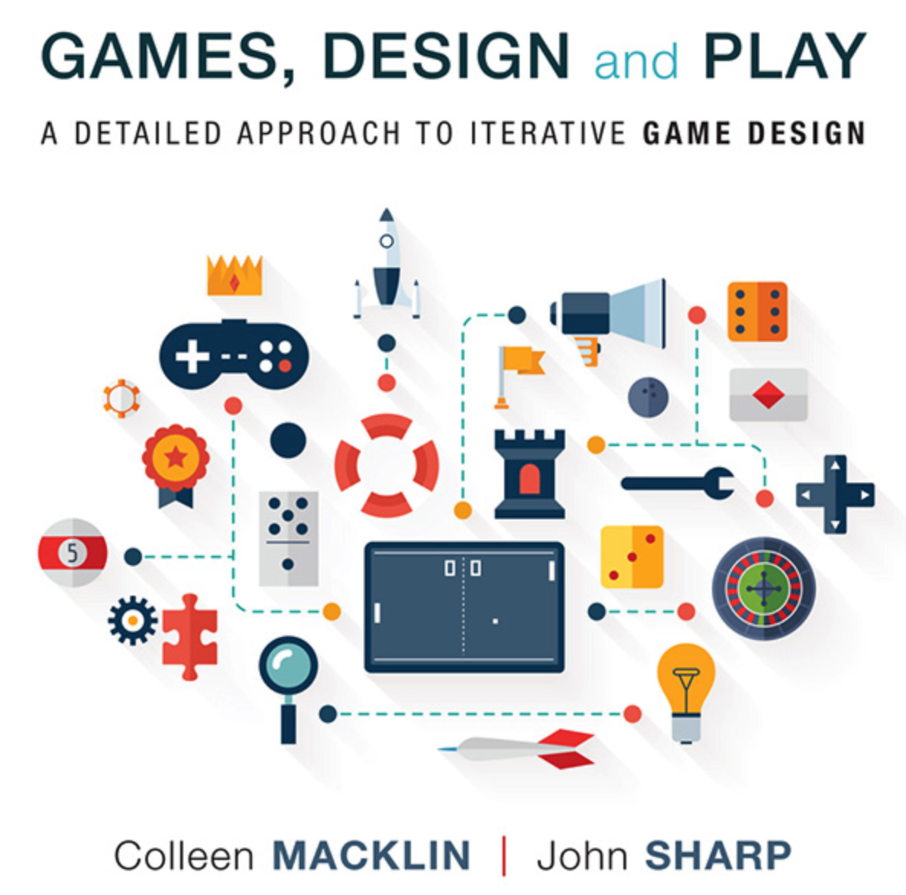
Game Design and Play
https://learning.oreilly.com/library/view/games-design-and/9780134392233/ch01.html
Free From O'Reilly Tech books online

Slide 7
An Overview:
User Interface (UI)
Data Layout
Communication
Behaviour
Modularity

Slide 8
Part 01: UI
Two important patterns
Game State Stack: for managing large scale transitions
Model-View-Controller (MVC): for in-game display

Slide 9

From the top:
Loading…
Splash Screen

Slide 10
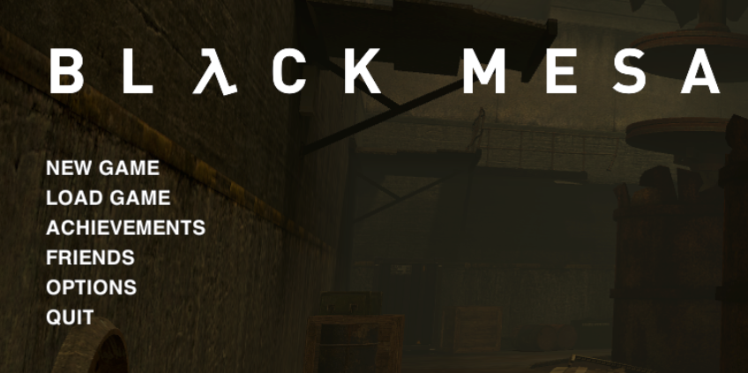
Settings
Main Menu
Play Campaign
Pick Scenario
Play the Game
Load Game

Slide 11
Settings
Main Menu
Play Campaign
Pick Scenario
Play the Game
Load Game

Slide 12
Game Screens Option 01: Finite State Machine (FSM)
De-initialize UI
Unload Everything
Pick Scenario
The init /deinit operations are symmetrical
Re-initialize UI again
Reload graphic assets
Reload scenario definitions

Slide 13
Settings
Main Menu
Play Campaign
Pick Scenario
Player choses: ‘back to main menu’ which path do we take?
Load Game

Slide 14
Game Screens, option 02: Stack!
State Stack
Main Menu
Time (flies like an arrow… fruit flies like a banana)

Slide 15
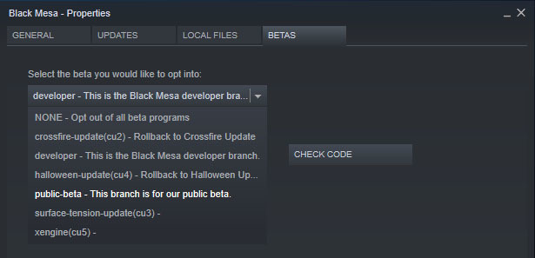
Game Screens, option 02: Stack!
State Stack
Settings
Main Menu
Main Menu
Time (flies like an arrow… fruit flies like a banana)

Slide 16
Game Screens, option 02: Stack!
State Stack
Settings
Main Menu
Main Menu
Main Menu
Time (flies like an arrow… fruit flies like a banana)

Slide 17
Game Screens, option 02: Stack!
I don't have pictures for this…
Play Campaign
State Stack
Settings
Play Campaign
Main Menu
Main Menu
Main Menu
Main Menu
Time (flies like an arrow… fruit flies like a banana)

Slide 18
Game Screens, option 02: Stack!
I don't have pictures for this…
Play Campaign
Pick Scenario => Xen
Pick Scenario
State Stack
Settings
Play Campaign
Play Campaign
Main Menu
Main Menu
Main Menu
Main Menu
Main Menu
Time (flies like an arrow… fruit flies like a banana)

Slide 19
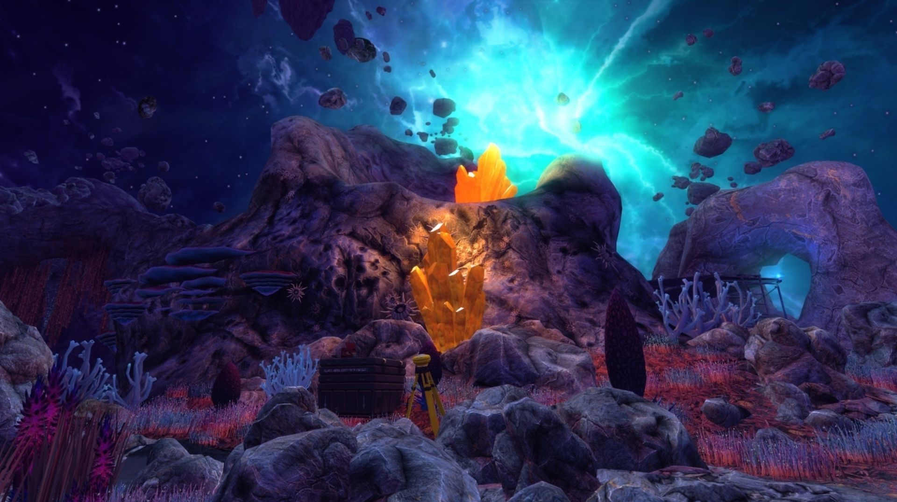
Game Screens, option 02: Stack!
Play the Game!
Pick Scenario
Pick Scenario
State Stack
Settings
Play Campaign
Play Campaign
Play Campaign
Main Menu
Main Menu
Main Menu
Main Menu
Main Menu
Main Menu
Time (flies like an arrow… fruit flies like a banana)

Slide 20
Game Screens, option 02: Stack!
I don't have pictures for this…
Play Campaign
Pick Scenario => Xen
Play the Game!
Pick Scenario
Pick Scenario
Pick Scenario
State Stack
Settings
Play Campaign
Play Campaign
Play Campaign
Play Campaign
Main Menu
Main Menu
Main Menu
Main Menu
Main Menu
Main Menu
Main Menu
Time (flies like an arrow… fruit flies like a banana)

Slide 21
Game Screens, option 02: Stack!
I don't have pictures for this…
Play Campaign
Play the Game!
Pick Scenario
Pick Scenario
Pick Scenario
State Stack
Settings
Play Campaign
Play Campaign
Play Campaign
Play Campaign
Play Campaign
Main Menu
Main Menu
Main Menu
Main Menu
Main Menu
Main Menu
Main Menu
Main Menu
Time (flies like an arrow… fruit flies like a banana)

Slide 22
Game Screens, option 02: Stack!
Play the Game!
Pick Scenario
Pick Scenario
Pick Scenario
State Stack
Settings
Play Campaign
Play Campaign
Play Campaign
Play Campaign
Play Campaign
Main Menu
Main Menu
Main Menu
Main Menu
Main Menu
Main Menu
Main Menu
Main Menu
Main Menu
Time (flies like an arrow… fruit flies like a banana)

Slide 23
Example: Settings Menu
Initialize UI Assets
Public class SettingsMenu: StateStackElement{
OnPushed (StateStack stack) OnActivated (bool firstTime) OnDeactivated () OnPopped() }
Show UI
Hide UI
Free UI assets
Benefits: this encapsulates large UI pieces and interactions inside objects that can be added and removed as needed.

Slide 24
On to MVC

Slide 25
MVC
? ??? What does MVC stand for? ??? ?
And how it relates to in game UI

Slide 26
MVC
A.Model View Controller
B. Marvel Vuniverse Cinematique
C.Making Videogames Complete
D. Micro View Concept
Stands for:

Slide 27
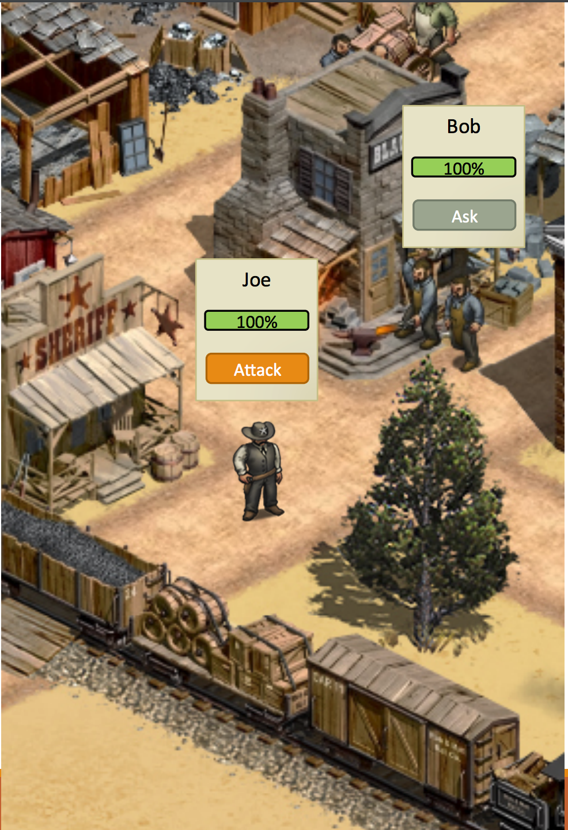
In-Game UI
NPC
Name Bob
Health 100
Inside the engine
NPC
Name Joe
Health 100
NPC
Name Ann
Health 100

Slide 28
Challenge
Game Systems shouldn’t know anything about UI
Yet they communicate all the time:
When players lose health, gain money, find items, etc.
UI updates
When the player clicks the “attack” button (interacts with the UI)
Combat systems should perform the attack
Causing the NPCs health to change which also makes the UI change

Slide 29
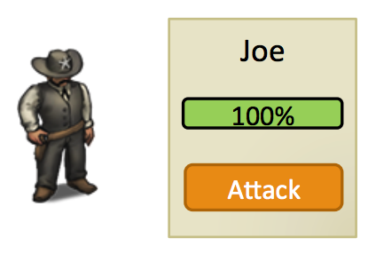
MVC
Model
Controller
Enemy
Health 100
View
Combat Manager

Slide 30
MVC
Listens for changes
Enemy
Health 100
Game Systems UI
Combat Manager
Translates user actions into game actions

Slide 31
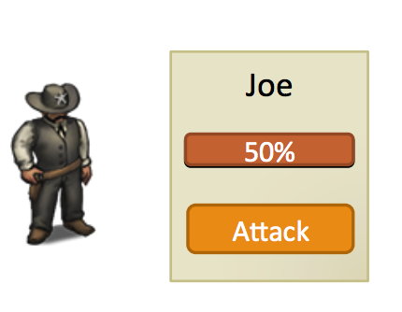
MVC
Updates propagate via event bus or observer callback
Enemy
Health 100
Combat resolution changes health
Combat Manager
Mouse click calls CombatManager.Attack()
Notes:
Look at and run MVC example http://cpp.sh/53nfp

Slide 32

More on MVC
Discussion
How does this relate to game design?
Why would we use it?
Why wouldn't we use it?
What would be better?
Model == Class
View == UI
Controller == Logic

Slide 33
Part 01: UI Summary
Model-View-Controller (MVC): helps separate out UI from the data it is displaying
UI should know about game data, but game data should not know about UI!
Game State Stack encapsulates large scale UI transitions

Slide 34
Part 02: Data Layout Patterns

Slide 35
Data Layout Patterns
FlyWeight
Share data across instances instead of duplicating
Good for shared immutable definitions
Memento
Put important internal state in a separate object
Simplifies implementation of save files

Slide 36
Flyweight
Separate intrinsic and extrinsic members for more efficiency
Intrinsic members are those that are unique to the instance. This should bring to mind instance members
Extrinsic are those that are shared amongst instances. This should bring to mind static members
http://www.cs.unc.edu/~stotts/GOF/hires/pat4ffso.htm

Slide 37
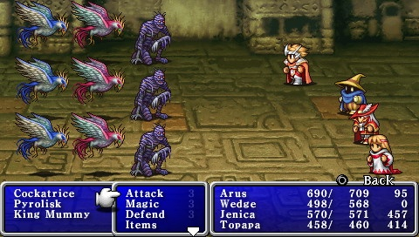
Data Sharing
Example: Crowd of Enemies
They have different Stats
But they look the same

Slide 38

Data Sharing
Example: Crowd of Enemies
They have different Stats
But they look the same
“Flyweight” pattern
Extract common data and share it
Unity Example:
Renderer.sharedMaterial
Unit ID# 1338
Health 100%
Mesh
Etc
Unit ID# 1337
Health 90%
Mesh
Etc
Unit ID# 1336
Health 10%
Mesh
Etc

Slide 39
Unity Gotcha #1
Components are not shared data
new class BirdComponent extends MonoBehaviour
If a new BirdComponent is added to five game objects, each gets a new instance!
Unity has a class for this: ScriptableObject
To share data across multiple game objects:
Subclass from ScriptableObject
Make an instance with shared data
Give the components a reference to this object
Unit ID# 1338
Health 100%
Mesh
Configuration
Unit ID# 1336
Health 10%
Mesh
Configuration
Scriptable Object

Slide 40

Unity Gotcha #2
Render.material
public class ExampleClass: MonoBehaviour { Void Awake() { Renderer.material.color = Color.red } }
Makes a copy of the material and changes the color of just this copy.
This gameobject is red, others are unchanged There are now two materials in memory!
Renderer.sharedMaterial
public class ExampleClass : MonoBehaviour { Void Awake() { renderer.sharedMaterial.color = Color.red } }
Modifies the material shared with others
This object and all game objects that share this material are now red

Slide 41
When to use FlyWeight
An application uses a large number of objects
Storage costs are high because of the sheer quantity of objects
Most object state can be made extrinsic
Many groups of objects may be replaced by relatively few shared objects once extrinsic state is removed
The application doesn't depend on object identity. Since Flyweight objects may be shared, identity tests will return true for conceptually distinct objects

Slide 42

Memento
Without violating encapsulation, capture and externalize an object's internal state so that the object can be restored to this state later
http://www.cs.unc.edu/~stotts/GOF/hires/pat5ffso.htm
https://www.oodesign.com/memento-pattern.html

Slide 43
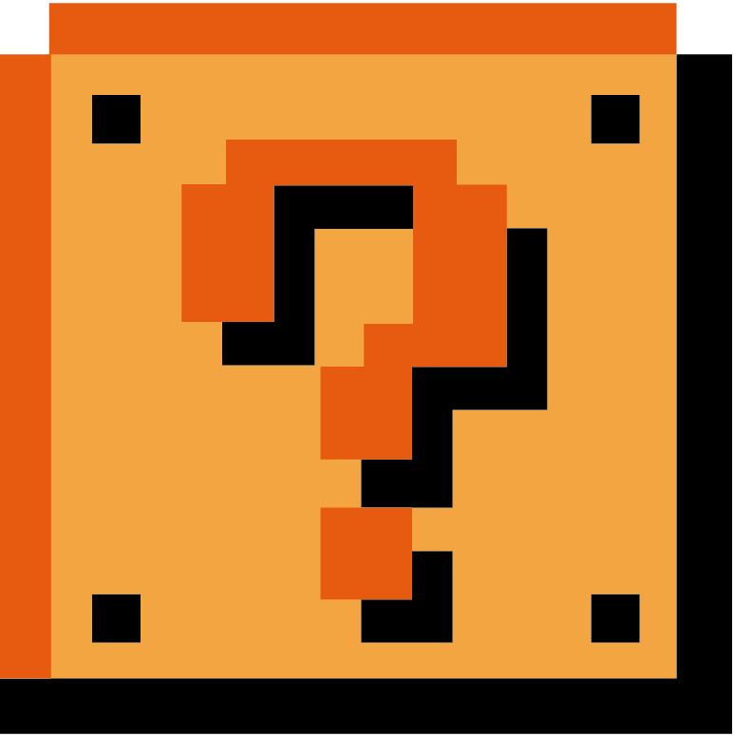
What is meant by encapsulation?

Slide 44
Data Model Separation
We probably want to save/load games
Saving EVERYTHING is not sustainable Or a good idea
Instead we save what is unique per instance
Unit ID# 1338
Health 100%
Mesh
Etc
Unit ID# 1337
Health 90%
Mesh
Etc
Unit ID# 1336
Health 10%
Mesh
Etc

Slide 45
Data Model Separation
We probably want to save/load games
Saving EVERYTHING is neither sustainable nor a good idea
“Memento” pattern
Separate out unique data
Only save/load that data
Unit
Data
Mesh
Etc
ID# 1338
Health 100%
Unit
Data
Mesh
Etc
ID# 1337
Health 90%
Unit
Data
Mesh
Etc
ID# 1336
Health 10%

Slide 46
Comparte with Unity Components
Typical unity component:
public class MyComponent : MonoBehaviour {
public Vector2 position; public int ID; public float health;
// … Code
public void DoAttack (...) {...} }
Separated version
public class MyComponent : MonoBehaviour {
public MyData data;
// … Code
public void DoAttack (...) {...} } public class MyData { // or struct?! public Vector2 position; public int ID; public float health; }

Slide 47
Memento How To
Essentially we create a go-between that stores our data
Whenever a change is made the go-between is updated
Yet another reason for getters and setters
Essentially Upon some change-action a 'Memento' is created that stores that change
When the game state is saved, only the mementos need be saved.

Slide 48
Memento Origins
Memento found its claim to fame in the 'undo' feature we all know and love.
Essentially when a letter, or word, or whatever, was deleted the 'delete' process triggered the creation of a memento.

Slide 49
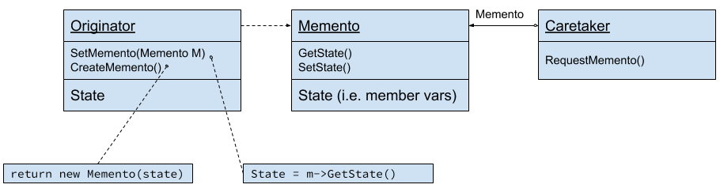
Layout
Caretaker process requests a memento from the originator
Originator and Memento share an interface
Originator and Memento would make an awesome superhero duo btw
Caretaker does NOT control or view the memento, it merely requests it and stores it
Can't access it
Originator may use the memento to set its state

Slide 50
Use the Memento pattern when:
a snapshot of (some portion of) an object's state must be saved so that it can be restored to that state later, and
a direct interface to obtaining the state would expose implementation details and break the object's encapsulation.

Slide 51
Part 2: Data Layout Patterns Summary
Flyweight
Share data across instances instead of duplicating
Use UnityEngine.ScriptableObject
Memento
Put important internal state in a separate object
This is not the ‘default’ way in Unity, but it makes it much easier to implement save files
Activities
Look at the code posted to iLearn

Slide 52
Part 03: Communication Patterns

Slide 53
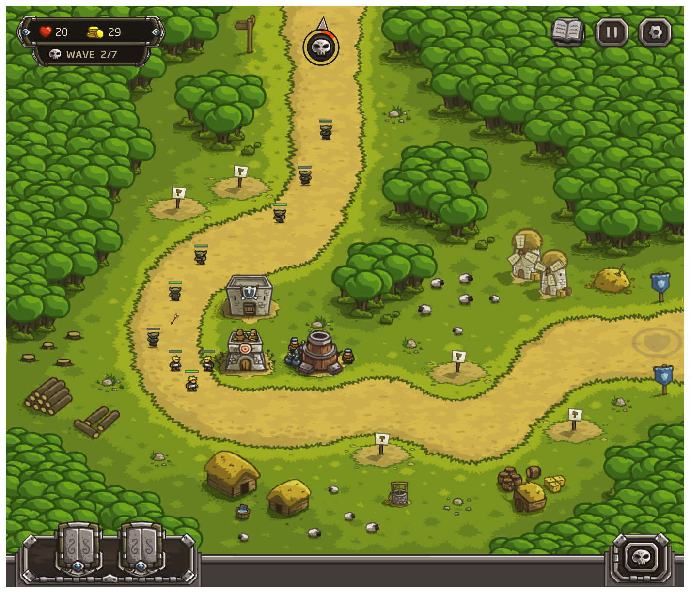
Looking at a TD game
Armour Games: Kingdom Rush
Health and Loot want to know when mobs get to the end or… don’t
Mobs will walk until they reach the end point
Towers want to know when a monster is near so it can attack

Slide 54
Communication Patterns
Much of gameplay code is observing game state updates and reacting
From entities to entities “a tower noticed a mob getting near”
From entities to systems “all mobs killed, gold earned, level cleared”
From systems to systems “Level cleared, new location unlocked + ???”
From systems to entities “When the level is clear, all units do a victory dance”
UI is a pervasive “uber-system”
Internal state of other systems usually need to be reflected in the UI
Player actions in UI usually affect other systems

Slide 55
Example
How do we implement: “a tower noticed a monster getting near?”
Options:
Towers check distance to all entites each frame
Mobs tell other entities “I am at (x,y)”
Higher-level optimized system for distance checks that the tower/mobs can monitor
No perfect answer, all have trade offs
Notes:
Make an activity here

Slide 56
Communication Patterns
Goal: Decoupler senders and receivers
Senders shouldn’t know who they need to inform
Two common ways
Observer pattern
Event bus pattern
Notice this hooks into the MVC pattern from before

Slide 57
Observer Pattern
public class Player{
public int Level {get; private set}
public event Action OnLevelUpdate;
public void UpdateLevel (int newLevel) { this.level = newLevel; OnLevelUpdate(); } }
public class UIManager{
public void INitializeUI () { var player = … / get a ref player.OnLevelUpdate += UpdateUI; }
private void UpdateUI () { var player = … // get a reference int newLevel = player.Level; } }
UpdateLevel()
Player
Event callback
UIManager
Other Listeners
Other Listeners

Slide 58
Observer Pattern
Observer Each Observer needs to:
Find a potential sender
Subscribe (and unsubscribe) to updates
Best for: System -> entities updates E.g. level finished -> all entities run away System -> System updates E.g. Player score increment -> UI Update

Slide 59
Event Bus / Command Pattern
public class GameEvent { // some fields: event type ID, ref to sender, etc }
Public class GameEventBus : MonoBehaviour {
private Queue<GameEvent> _events; public event Action<GameEvent> OnGameEvent;
Public void AddEvent (... event data) { While (_evemts.Count > 0) { GameEvent evt = _event.Dequeue(); OnGameEvent(evt); } } }
Game Event
Game Event
…
Game Event
On update(), send all events to all subscribers
Entity
Entity
Entity

Slide 60
Observer
Event Bus
Observer Each observer needs to:
Find potential sender
Subscribe (and unsubscribe) to updates
Best for:
systems -> systems
E.g. Player score increment -> UI Update
systems to entities
E.g. Level finished -> all entities run away
Event Bus
One global bus for everyone to subscribe to
Each event goes out to all subscribers
Optimization: different busses for different events
Best for:
entities -> entities
E.g. Player dies -> All mobs do a happy dance
entities -> systems
E.g. Mobs die -> player score increment

Slide 61
Part 03: Communication Patterns Summary
Observing game state updates and reacting to them:
From entities to entities Many different kinds of senders/receivers: Event Bus
From entities to systems
From systems to systems few senders / few receivers: observer
From systems to entities

Slide 62
Part 04: Behaviours

Slide 63
Behaviours
Implement different ways of pathfinding (for example)
Strategy Pattern
Separate the algorithm from the data
Making sure they do everything in order
Command pattern
‘Action queue’ in an RTS

Slide 64

Let’s look at our units
Now we have 2 mobs with different behaviours:
Walking mobs
Spawns
Follows path
Attacks
Flying mobs
Spawns
Flies right to the end point
Waits for 5 seconds
Attacks

Slide 65
Pathfinding
Suppose we want different pathfinding for walkers, fliers and other mobs
InitializeGrid(mGrid); if (walker) { findWalkingPath(); }else if (flier) { findDirectPath(); } return mGrid;
… neither modular nor extensible! … VERY tempting though

Slide 66
Strategy Pattern pt0
Class GameAreaContext{
}
Keep all shared state in one object
Encapsulate algorithm in other objects that can be switched in and out

Slide 67
Strategy Pattern pt1
Class GameAreaContext{
}
IPathAlgorithm
FindPath(context);
AStarPath
DirectPath
… and then the entity picks the algorithm and passes it to the current game context!

Slide 68

Strategy Pattern pt02
InitializeGrid(mGrid); if (walker) { findWalkingPath(); }else if (flier) { findDirectPath(); } return mGrid;
InitializeGrid(mGrid); IPathFindingAlgorithm algo = GetAlgorithm();
algo.findPath(mGrid); return mGrid;

Slide 69
Back to the Example
Flying mob found the path
Now we want it to perform its dance:
Flying mob Spawns
Flies right to the end point
Waits for 5 seconds
Attacks
We will use this to introduce the Command Pattern!

Slide 70
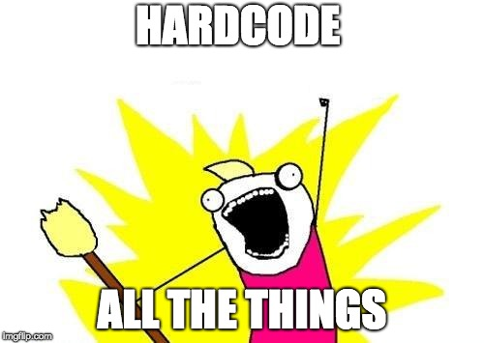

Bad version
On each update:
if ( !_spawned) { SpawnMonster(); _spawned = true; }else if (! NearGoal()) { FlyToGoal(); }else if (! TimerStarted()){ StartTimer(); }else if (TimerFinished()){ Attack(); }
This is UGLY code
Also, this is just a handmade state machine…
It also makes baby Turing cry

Slide 71
Okay Version - finite state machine
FSMs are easy to implement
messy once they scale up, or add different variants
Spawn
Wait
Wait
Fly directly to goal
Spawning done
Near goal

Slide 72
Better Version - Action Sequence
Spawn at (x,y)
Fly direct to (x’,y’)
Wait 5 seconds...
ATTACK!
DONE!
Each of these is a data object inside a Queue<> that fully encapsulates that behaviour

Slide 73
Better Version - The action queue
Spawn at (x,y)
Fly direct to (x’,y’)
Wait 5 seconds...
ATTACK!
DONE!
Fly direct to (x’,y’)
Wait 5 seconds...
ATTACK!
DONE!
Notes:
Spawner queue pops action

Slide 74
Better Version - The action queue
Spawn at (x,y)
Fly direct to (x’,y’)
Wait 5 seconds...
ATTACK!
DONE!
Fly direct to (x’,y’)
Wait 5 seconds...
ATTACK!
DONE!
Wait 5 seconds...
ATTACK!
DONE!
Notes:
Pop fly direct action

Slide 75
Better Version - The action queue
Spawn at (x,y)
Fly direct to (x’,y’)
Wait 5 seconds...
ATTACK!
DONE!
Fly direct to (x’,y’)
Wait 5 seconds...
ATTACK!
DONE!
Wait 5 seconds...
ATTACK!
DONE!
ATTACK!
DONE!
Notes:
Pop attack action

Slide 76
Better Version - The action queue
Spawn at (x,y)
Fly direct to (x’,y’)
Wait 5 seconds...
ATTACK!
DONE!
Fly direct to (x’,y’)
Wait 5 seconds...
ATTACK!
DONE!
Wait 5 seconds...
ATTACK!
DONE!
Now figure out what to do next and refill the action queue with MOAR ACTIONS!
ATTACK!
DONE!
DONE!
Notes:
Pop attack action

Slide 77
Better Version - Action Sequence
Flying monster action queue:
Spawn at (x,y)
Fly direct to (x’,y’)
Wait 5 seconds...
ATTACK!
DONE!
Walking monster action queue:
Spawn at (x,y)
Compute A* path
Use A* path
ATTACK!
DONE!
Mix and match functionality
Easy to implement
USed in a lot of games (RTSs, the Sims, etc)

Slide 78
Command Pattern
Split up behaviour logic into steps
Each step is its own class
Create a queue of commands
On each frame:
Let only the first command run its logic
Ask the first command if it is done
If done, pop it and start the next one
This also shows up anywhere you have a sequence of things that need to take a while but must run in sequence

Slide 79
Part 04: Behaviours Summary
Command
Encapsulate small behaviours inside classes
Instead of hard coding a state machine, use a Queue<> of those commands
The head of the queue is the only one that actually runs
Then when it’s done, pop and move to the next one
Strategy
When you have multiple variants of the same behaviour, don’t use if/else statements!
Encapsulate each variant in a class and switch them at runtime

Slide 80
Part 05: Modularity

Slide 81

Modularity Example
A game system might need multiple implementations and to switch between them to:
match hardware (e.g. read from a controller or keyboard and mouse)
match the platform (e.g. different filesystem APIs (iOS vs Android)
improve performance (e.g. replace 3D audio with 2D)
aid in debugging (e.g. show all errors in debug mode, log to file in release)
Game logic should not know anything about any of this!

Slide 82
Modularity
Example 1:
Switch behaviours at runtime based on game or player preference
Example: Error logging, switching input mappings (don’t tell Bethesda*)
Example 2:
Quarantine platform-specific details without affecting the rest of the code
Example: High score table
* I installed Fallout 4 3 times because I thought it was broken when it didn’t read from the keyboard… turns out the keyboard is ignored if there is a controller present… mostly.

Slide 83
Logging Service Example
We want alerts during development if something doesn’t look right:
var enemies = LoadDefinitions(“enemy”);
if (enemies.count == 0) { UIManager.ShowError(“Failed to Load!!!);
}
But when doing a demo, this would look bad! Instead, log errors quietly to a log file:
var enemies = LoadDefinitions(“enemy”);
if (enemies.count == 0) { #if unity_editor UIManager.ShowError(“Failed to Load!!!); #else TextLogger.LogError(“Failed to Load!”); }
This is ugly. Game code should neither know nor care.

Slide 84
A better logging service
Abstract class Logger
Static ILogger instance;
Abstract void LogError(string)
At initialization:
Logger.instance = new TextFileLogger(“c:\log.txt”);
In game code:
var enemies = LoadDefinitions(“enemy”); if (enemies.count == 0) { Logger.instance.LogError(“Failed to load!”); }
TextFileLogger
void LogError(string)
ErrorDialogLogger
void LogError(string)
Write to text file
Display a popup

Slide 85
State Pattern
Encapsulate functionality in interchangeable object that share the same interface
Switch objects at runtime, to make it look like system’s behaviour changes
Either a single “currently active” state
Or maybe a stack of states
This pattern show up everywhere
If you’re doing a lot of ‘if-then’ checks based on game state, this is the pattern for you!

Slide 86
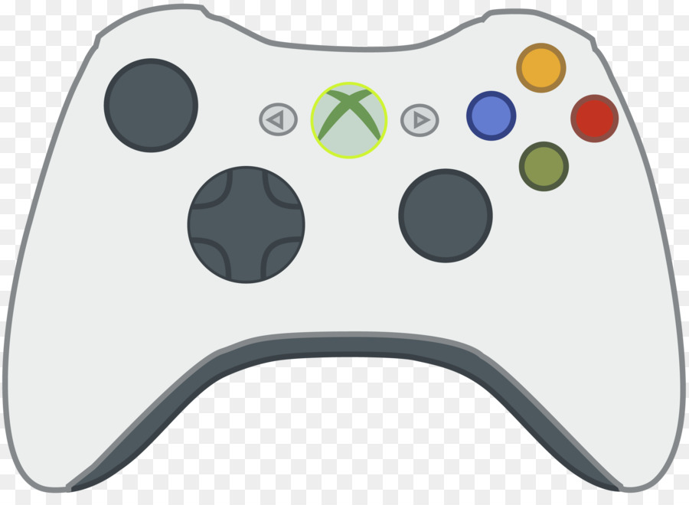
State Pattern: Input Handlers
IInputHandler
Walking Handler
Flying Handler
Swimming Handler
Standard Controls
Standard controls + invert up/down
Sluggish controls + move up/down under water
IInputhandler currentHandelr

Slide 87
High Score Example
We have platform dependent parts of the game
Example: posting high scores to a leaderboard
iOS, Android -- provided by the OS
Windows -- requires 3rd party SDK such as Steam, Origin, Uplay, Etc.
BAD IDEA:
int score = DoSomeCalculations() {
#ifdef IOS_BUILD IOSService.POstScore(board, score); #endif
#ifdef WINDOWS_BUILD InitializeSteamLibrary(); SteamService.PosrtScore(score); #endif
This is ugly. Game code should neither know nor care.

Slide 88
High Score Example
Pattern: “Bridge”
Solution
We use the state pattern for actual functionality
A parent service contains and hides one of those implementations
void PostHighScore(){
int score = DoSomeCalculations(); HighScoreManager.instance.PostScore(score); }
HighScoreManager
Void PostScore(int)
Private IHighScore impl;
Interface IHighScore
Void PostScore(int)
SteamHighScoreImpl
iOSHighScoreImpl
Void PostScore(int)
Void PostScore(int)
(initialize Steam SDK)
(call SDK)
(Call the iOS SDK)

Slide 89
Variation on the theme 01
Problem: How do we initialize this service?
Option 01: Singleton - initialize itself
Very convenient (“pay for what you use”)
What if we want to switch implementations?
abstract public class Logger { private static Logger _instance;
public static Logger getInstance () {
if (_instance == null) {
_instance = new TextFileLogger("c:\log.txt");
}
return _instance;
}
}
Game Code:
Logger.getInstance().LogError(“blah!”);

Slide 90
Variation on the theme 02
Problem: How do we initialize this service?
Option 01: Singleton - initialize itself Option 02: Static Service Locator
Better! Now we control implementation
Needs and initialization call
abstract public class Logger { public static Logger instance; public void LogError (string text);
Initialization Code:
Logger.instance = new TextFileLogger(“C:\log.txt”);
Game Code:
Logger.instance.LogError(“blah”);
Notes:
For the love of Stalman don’t hard code your file paths either.

Slide 91
Variation on the theme 03
Problem: How do we initialize this service?
Option 01: Singleton - initialize itself Option 02: Static Service Locator Option 03: “God object” service locator
Groups entire families of services
public class Services { public static Logger logger;
public static void InitializeServices() { Logger = new TextFileLogger(...); }
public static void InitializeServicesDebug() { Logger = new ErrorDialogLogger(); }
Initialization Code:
ServiceLocator.InitializeServices();
Game Code:
Services.logger.LogError(“blah”);
Notes:
For the love of Stalman don’t hard code your file paths either.

Slide 92

Part 05: Modularity Summary
State Pattern - Encapsulate different variants into classes
Game code doesn’t have to know which platform it’s running on, etc
No if/else or #ifdefs!
Bridge Pattern - Hides different behavioral States inside it
Donald Knuth approves

Slide 93
Overall Review
UI game state stacks, model-view-controller
Data Layout shared read-only config data, externalized saved data
Communication event callbacks, global event bus
Behaviour command queues, strategy objects
Modularity state pattern, hiding implementation details
– Decouple dependencies between game systems – Make it easier to mix and match behaviour – Speed up development and iteration

